Slide 1
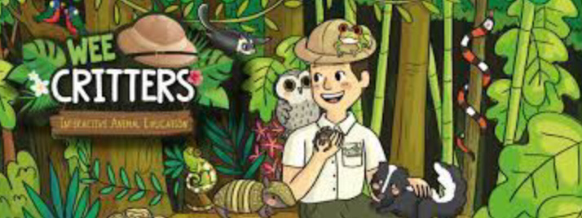
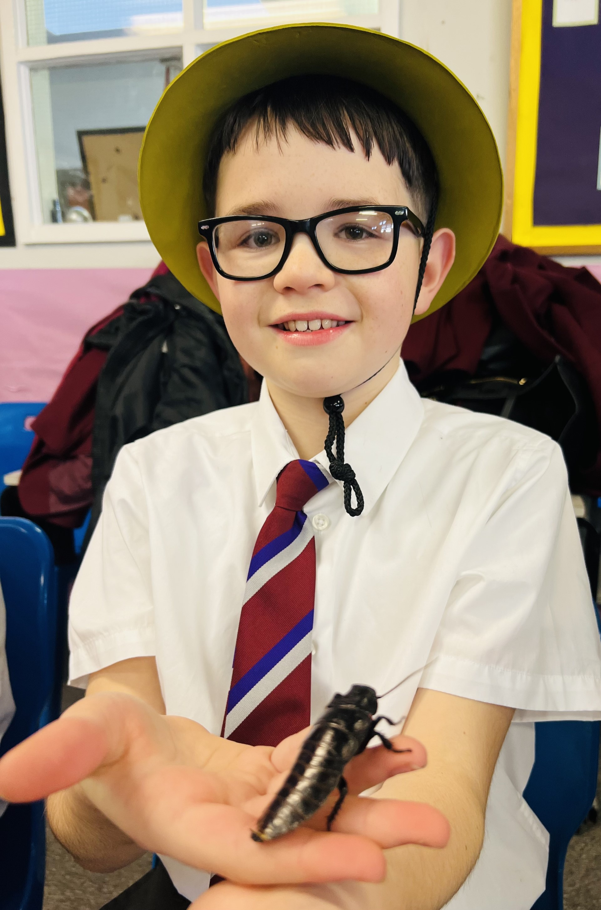
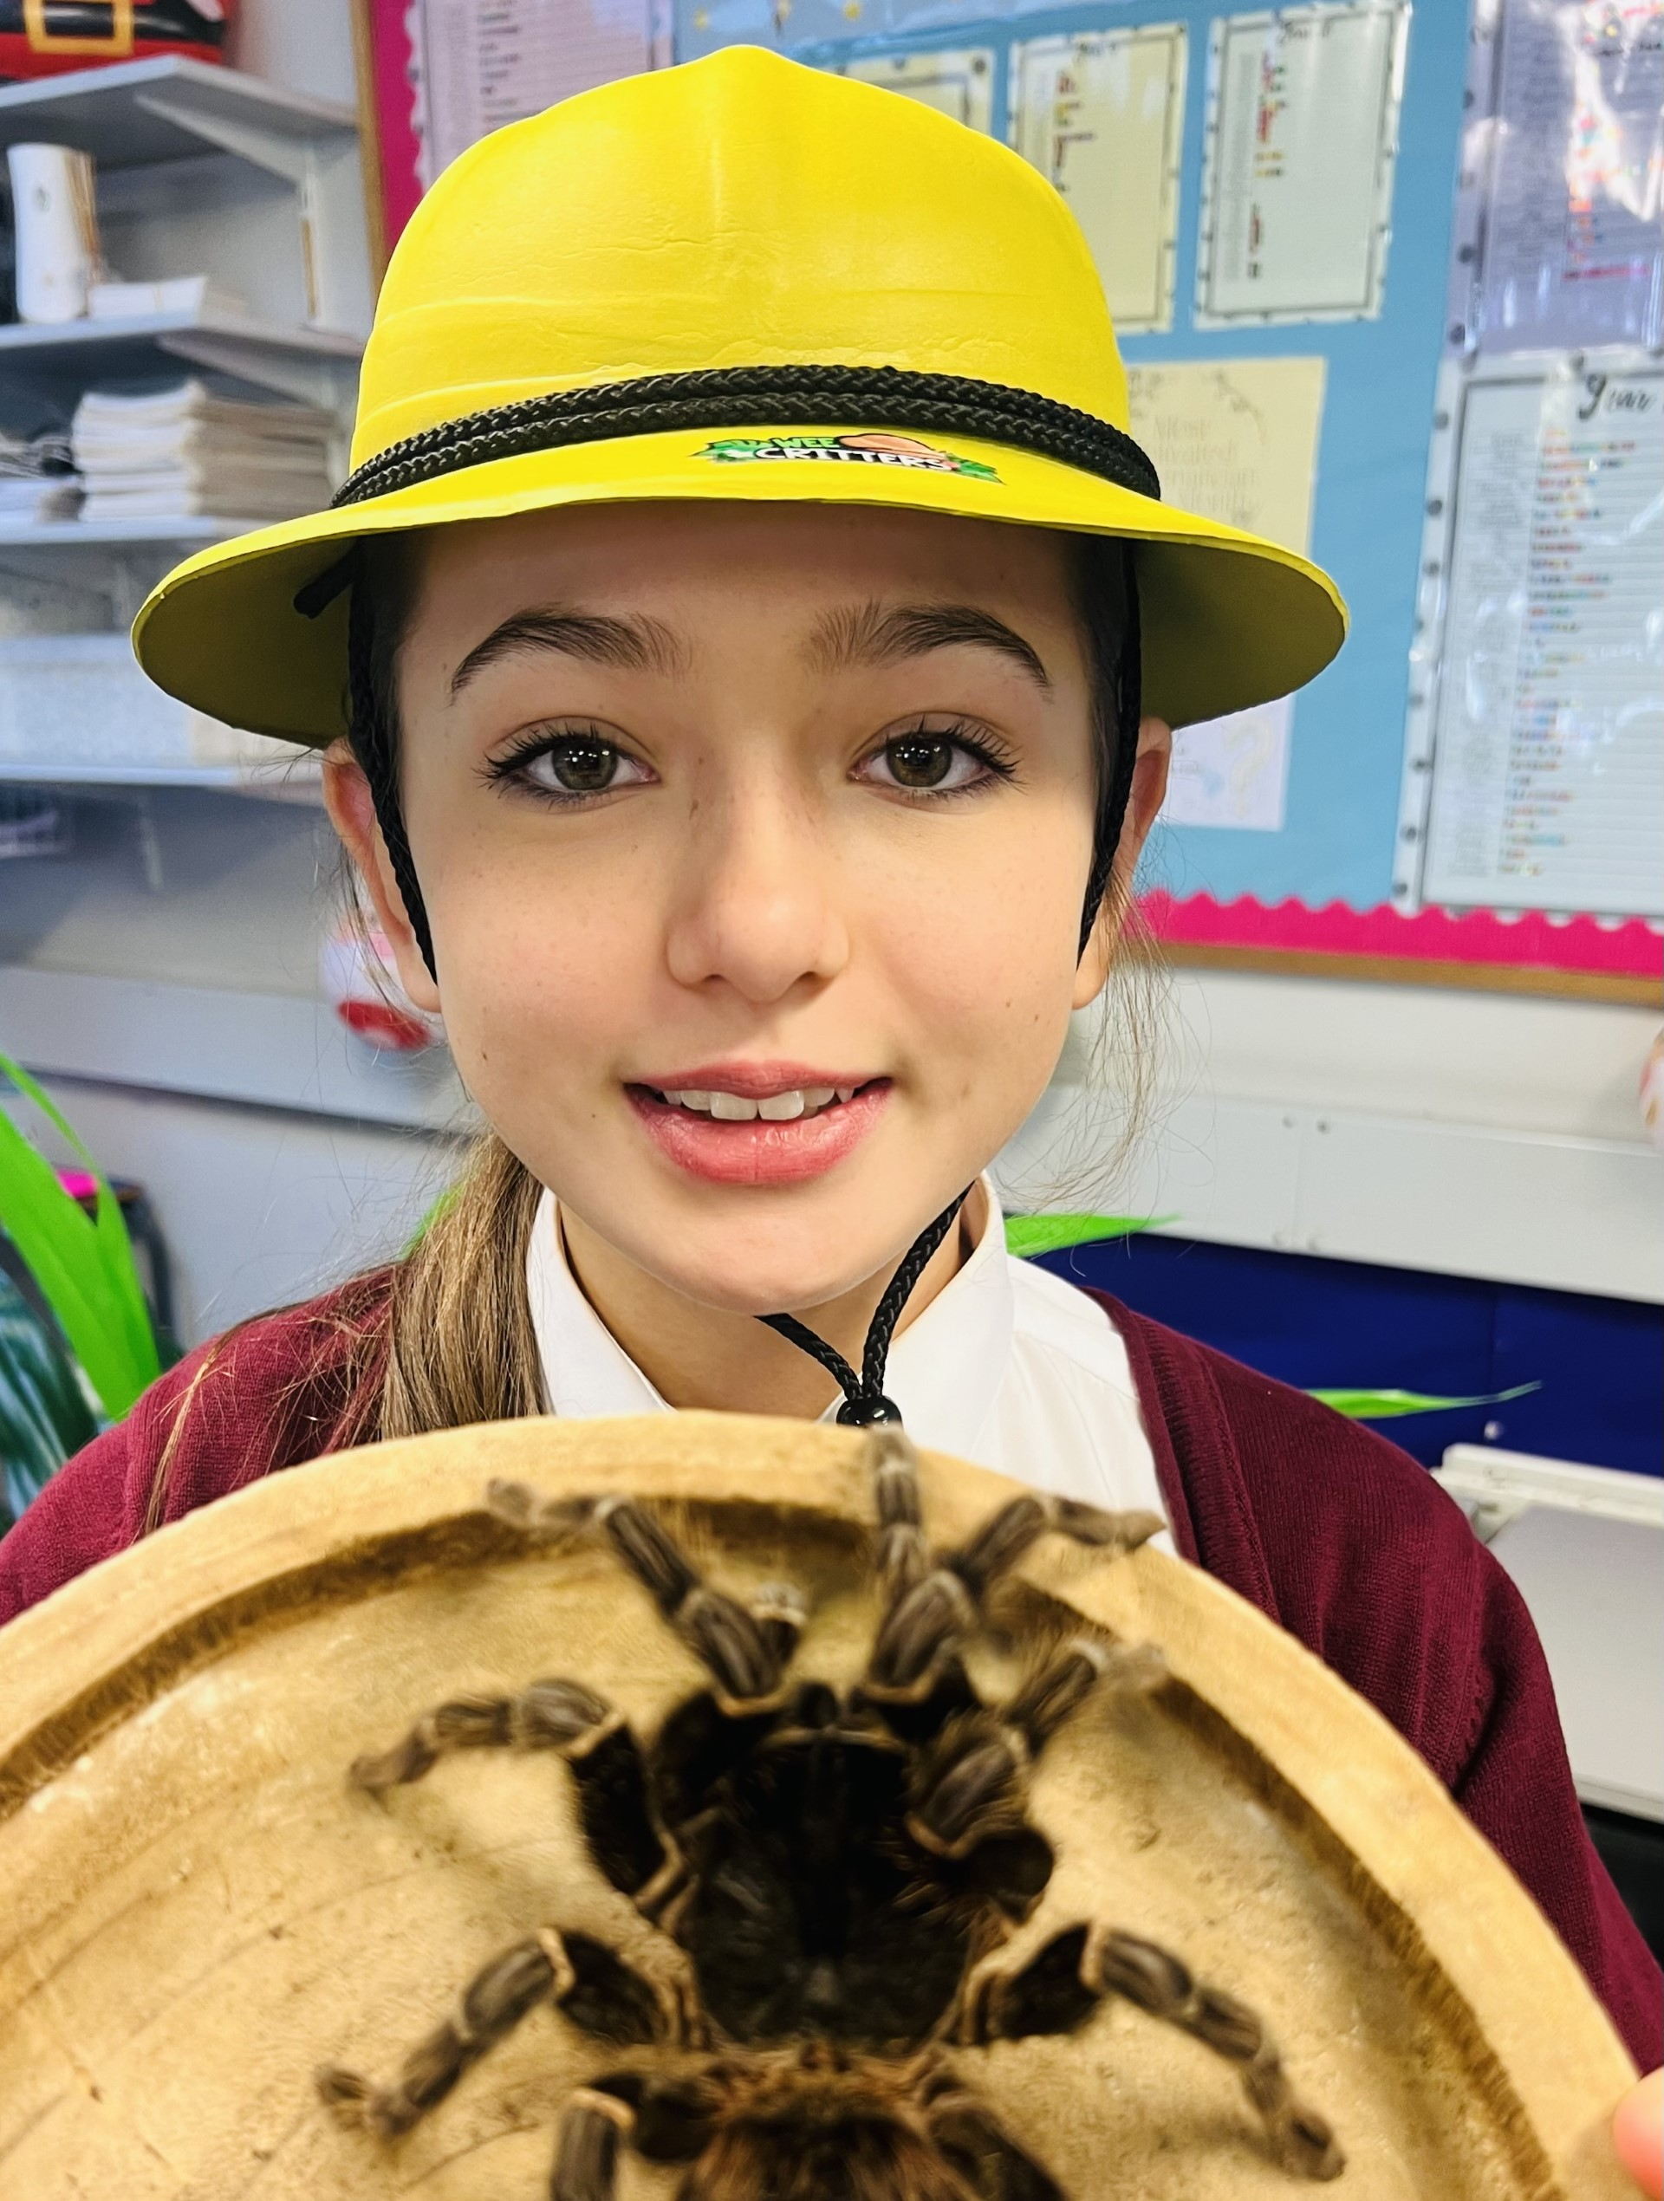
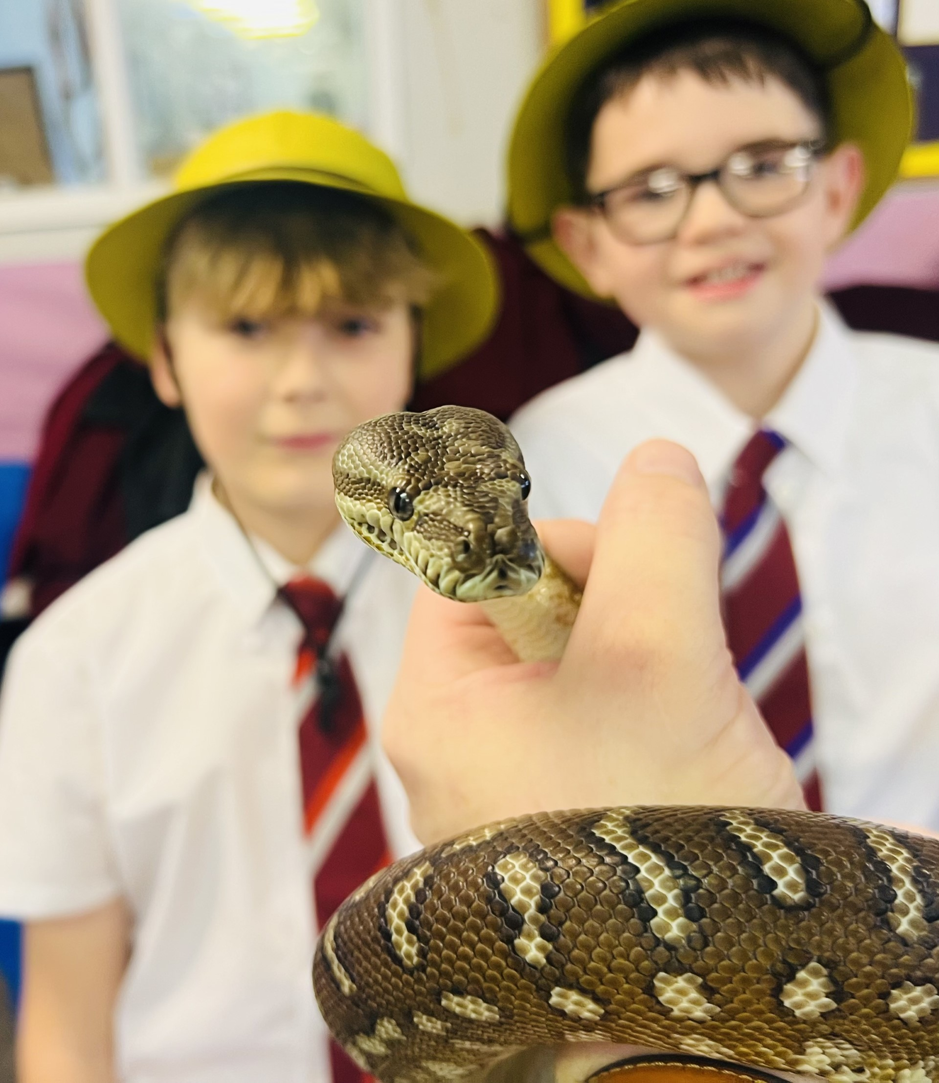
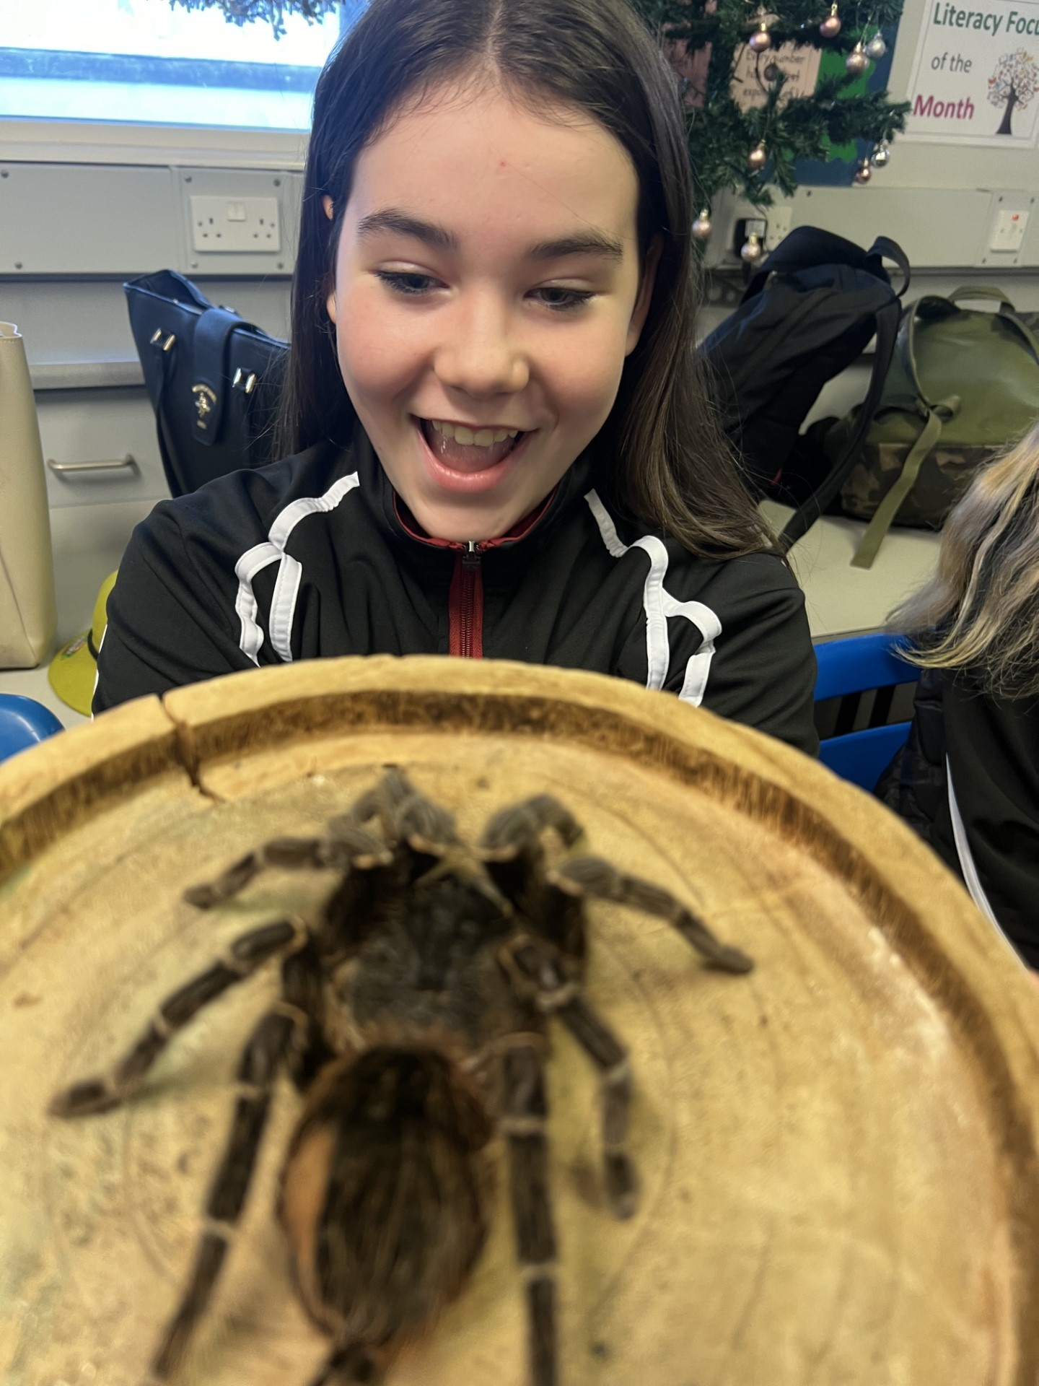
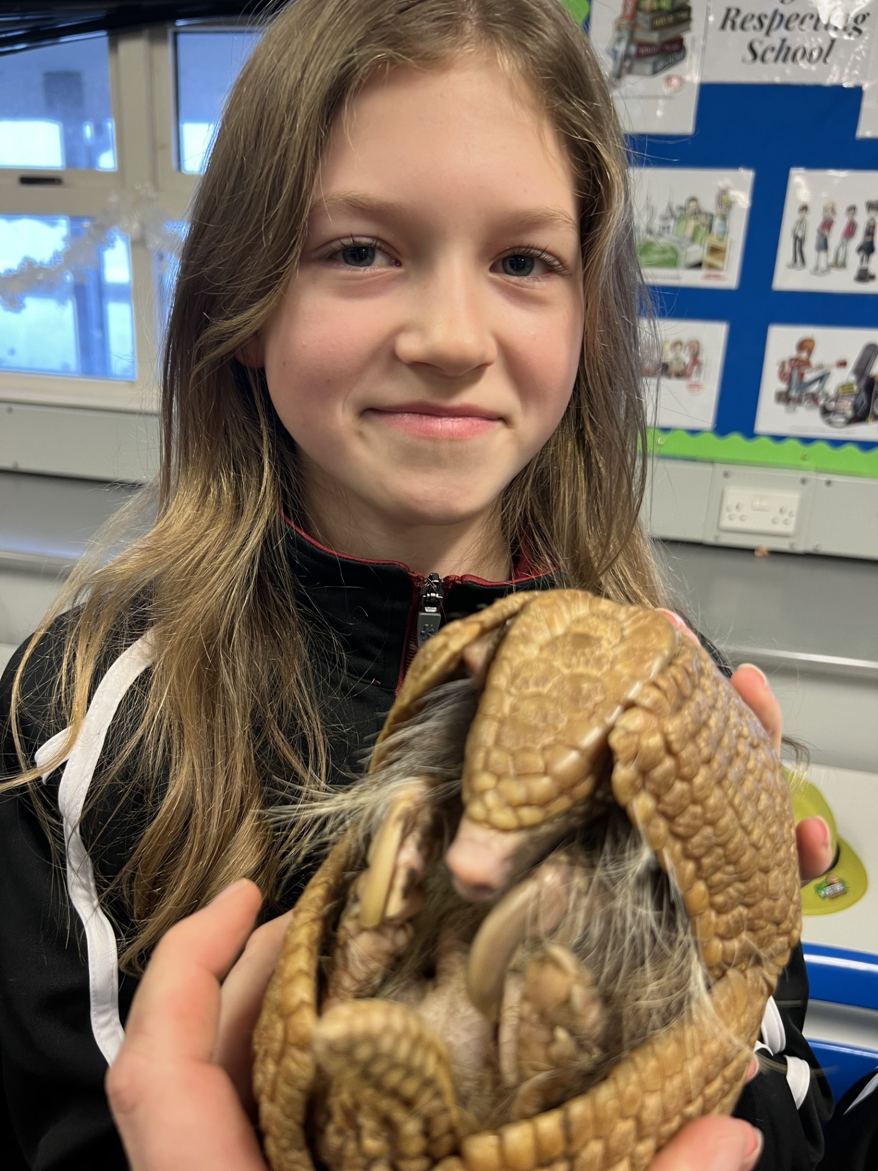
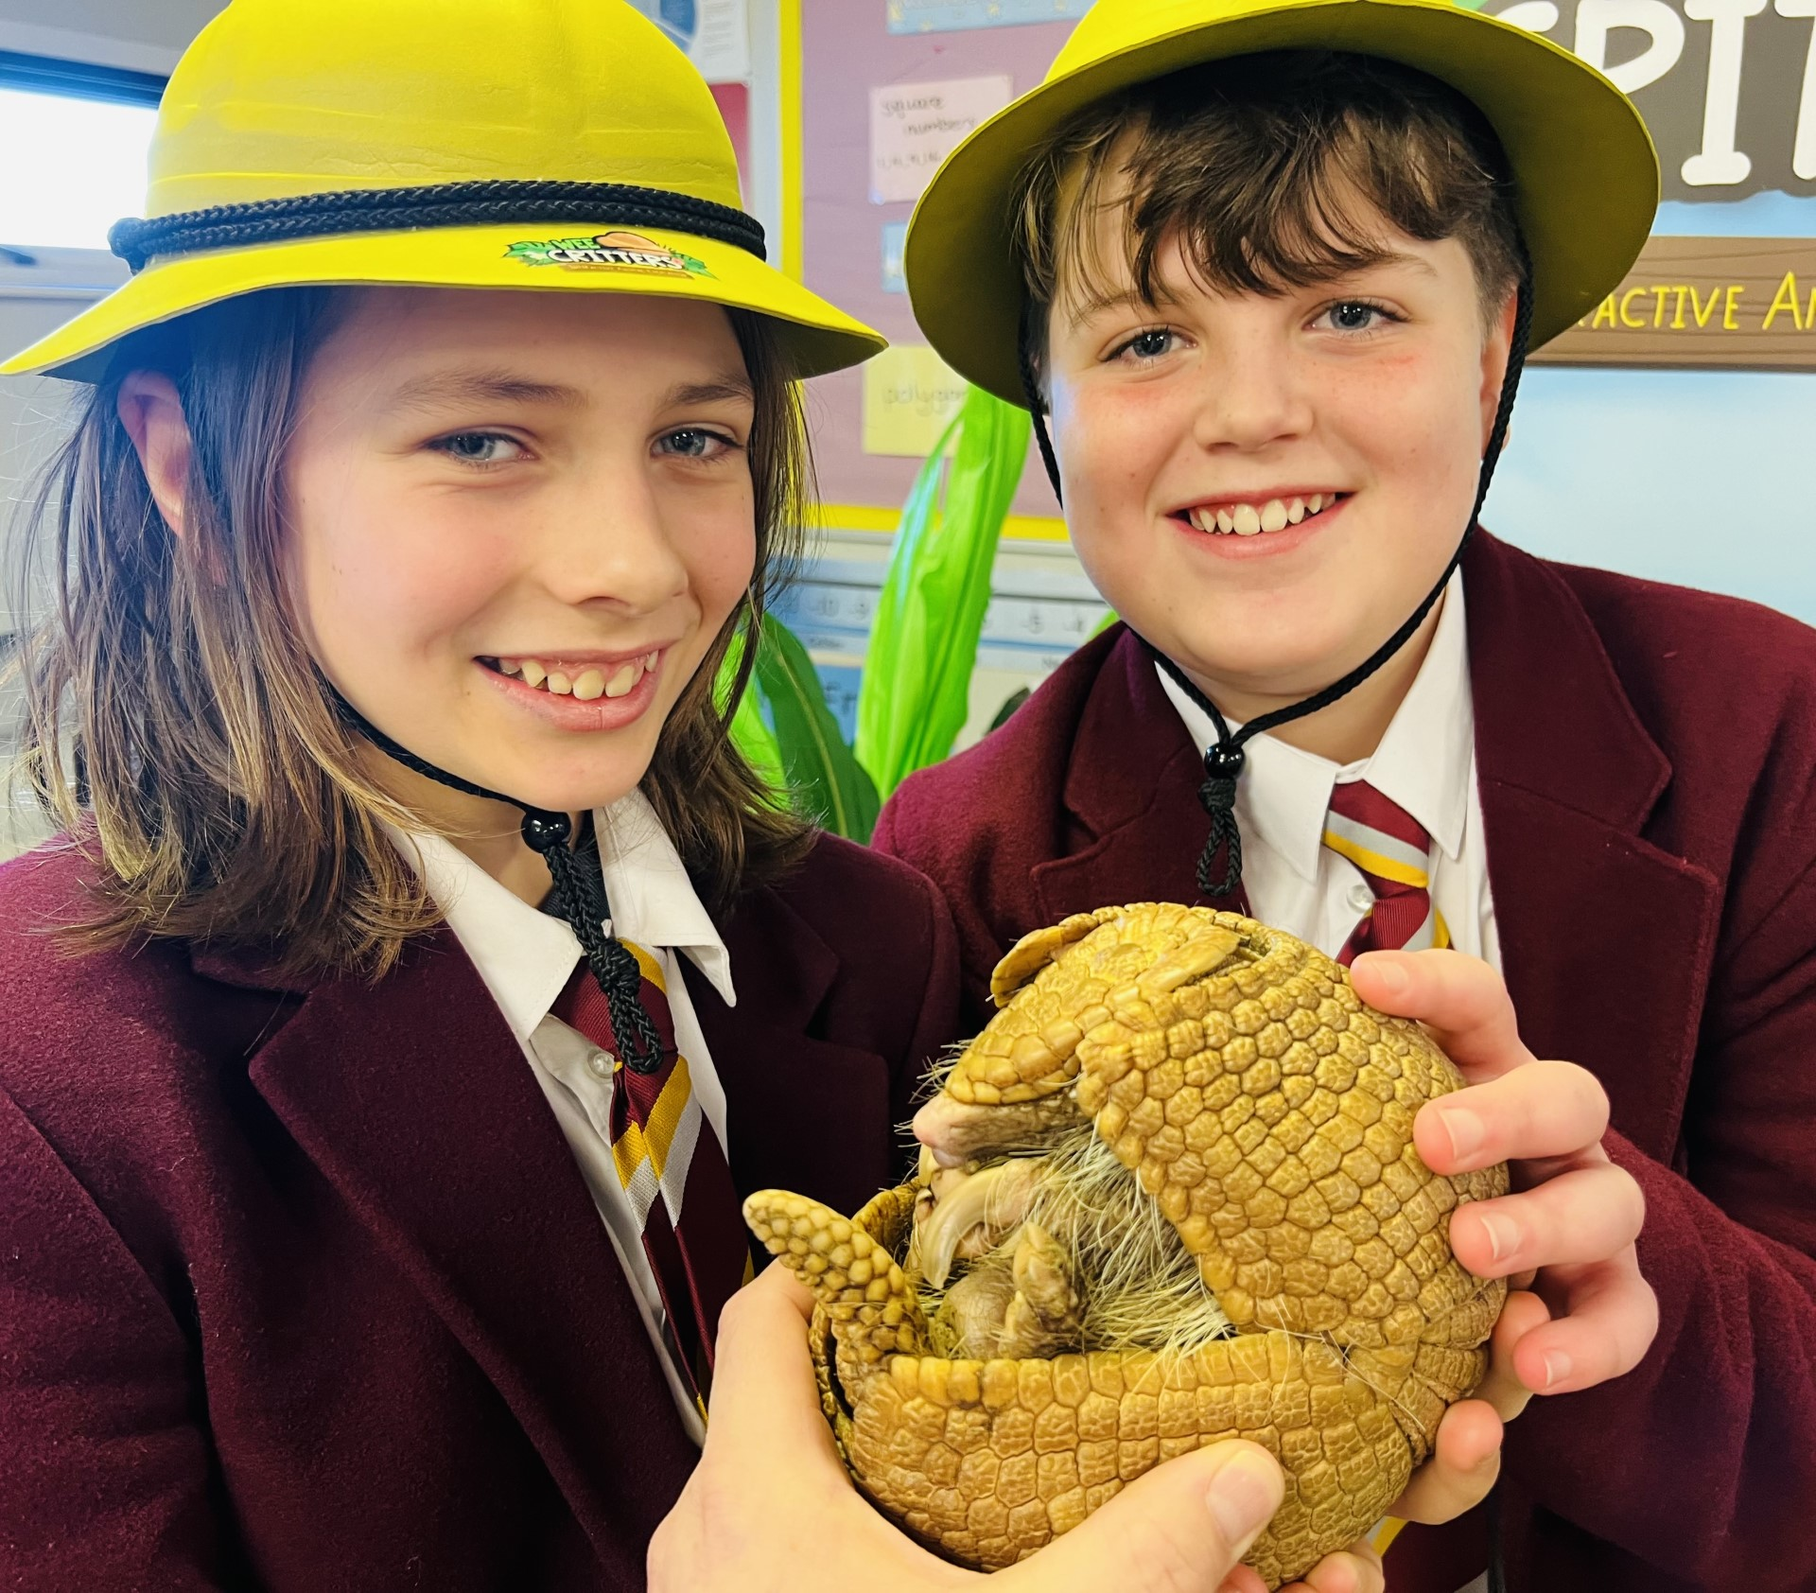
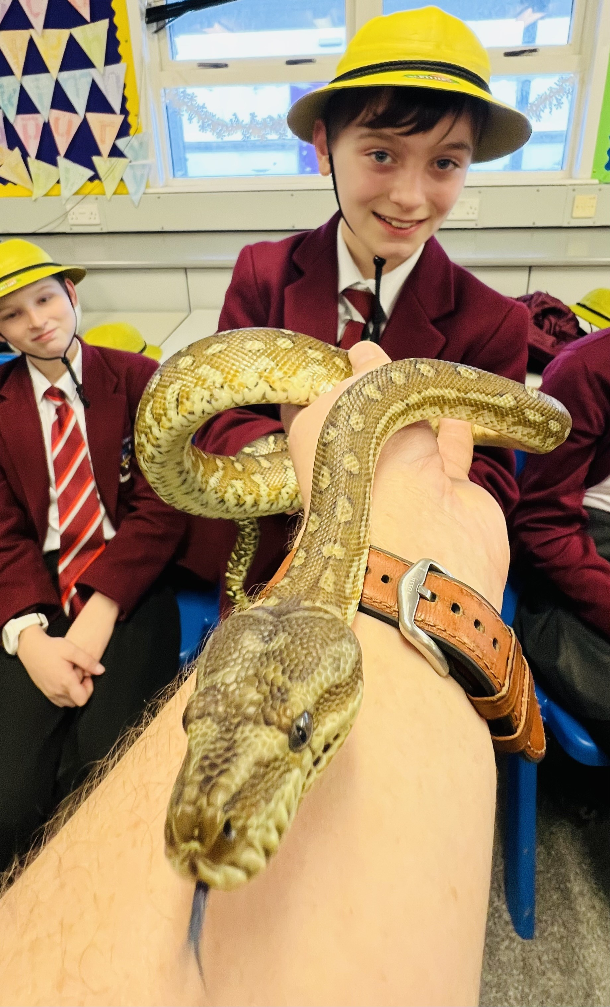
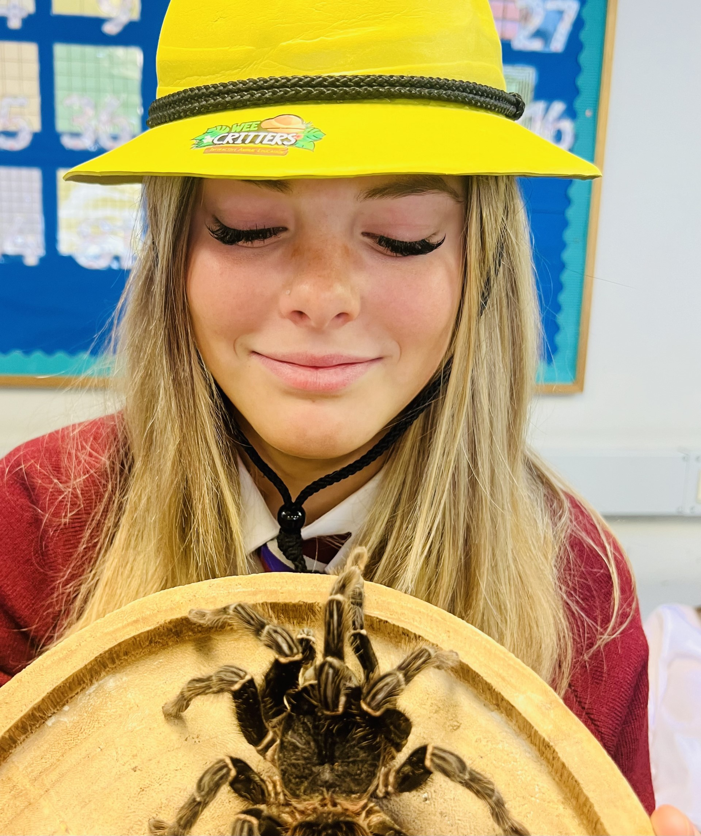
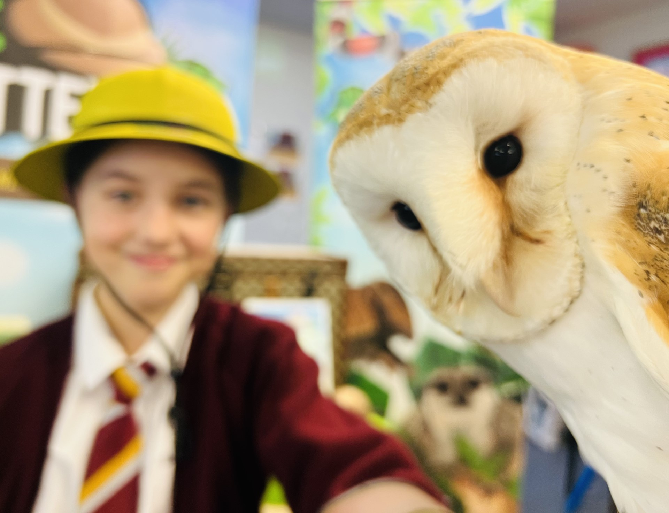
strangford Integrated college
Eco Schools
December 2023
WHATS COMING UP IN
2024?
We are making good progress with our outdoor learning space funded by Live Here Love Here. Cardy Timber are working hard to construct our outdoor blackboard. The birdhouses, nesting boxes, bug hotels and seeds have arrived, and we look forward to working alongside the gardening club to create this inclusive education and nurturing space.
In the new year we aim to further increase our rate of recycling and reduce litter with some new initiatives – watch this space!
WHAT HAVE WE BEEN WORKING ON?
Allan the explorer from 'Wee Critters' (interactive animal educational experience) visited our year 8 students this month. Both students and staff who attended have provided some fantastic feedback. Allan brought in a range of animals for our students to meet, with a focus on the circle of life and the importance of environmental conservation for the survival of these species – providing some fantastic cross curricular links to Science and Geography.
ECO ETHOS
"BE CLEAN, BE GREEN, BE A RECYCLING MACHINE"

