Slide 1
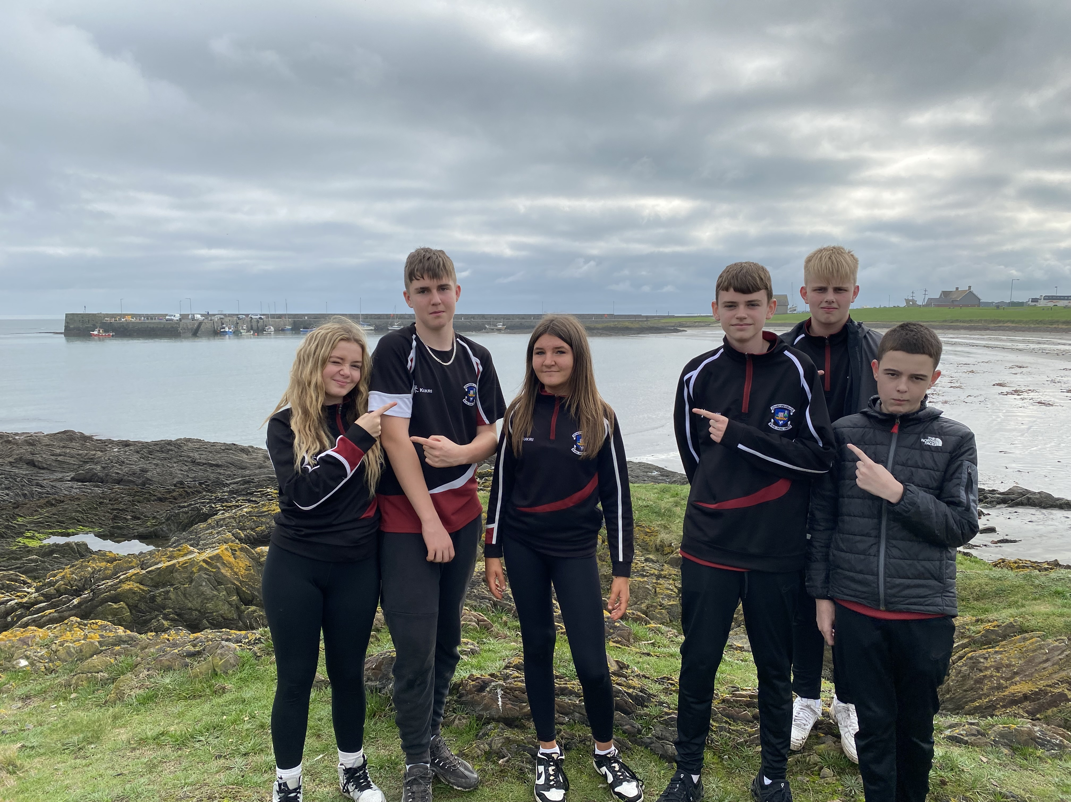
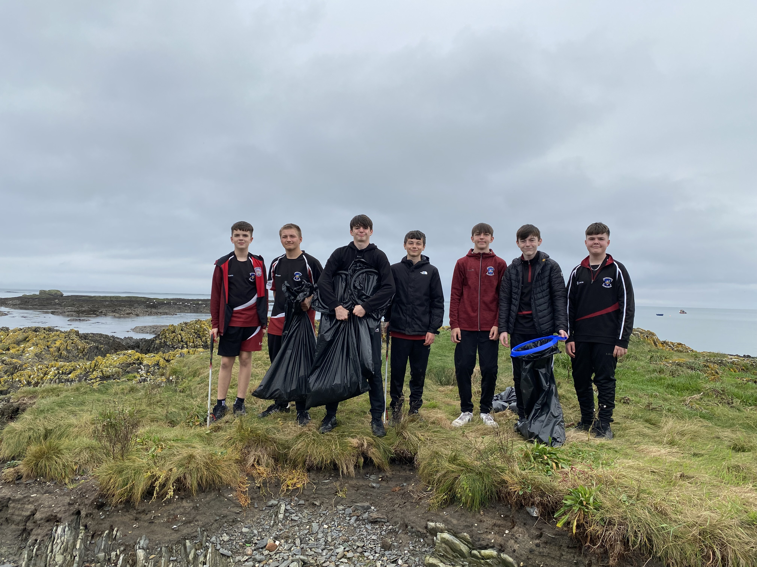
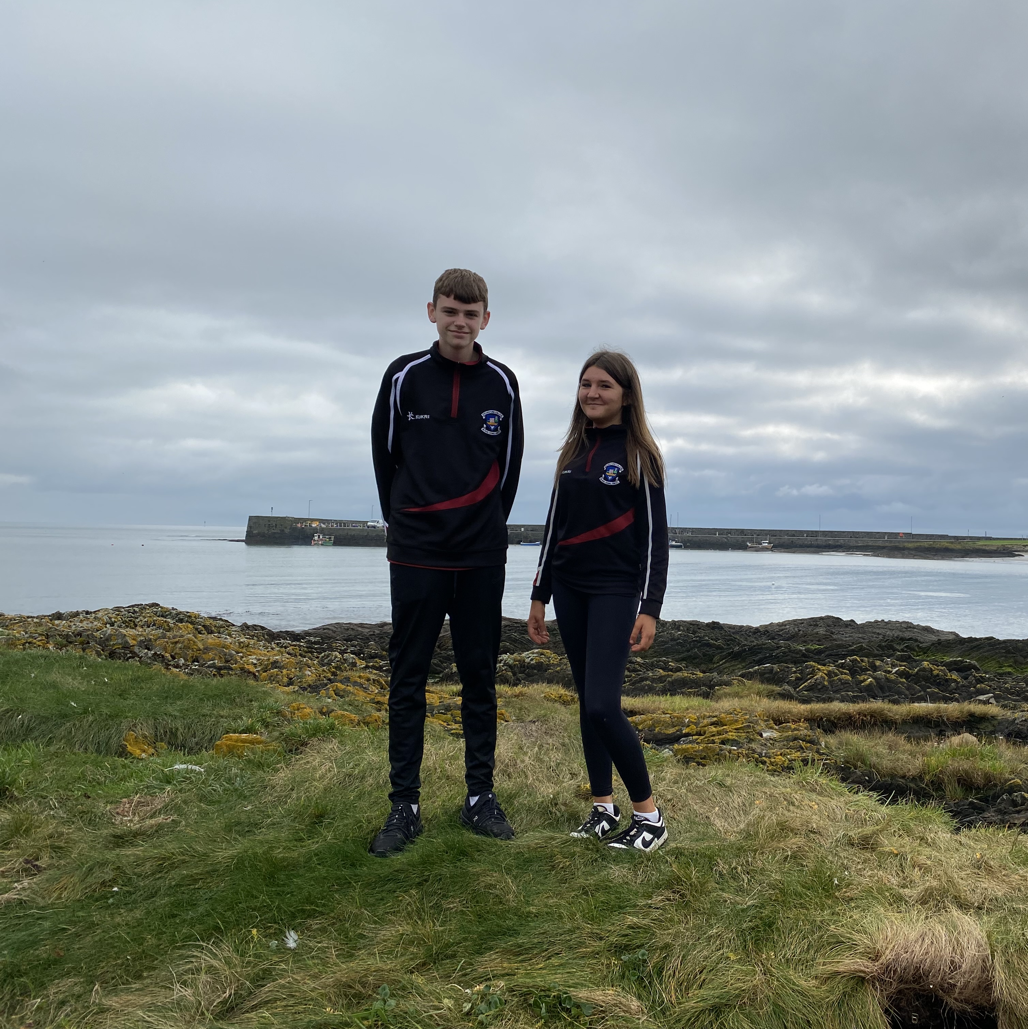
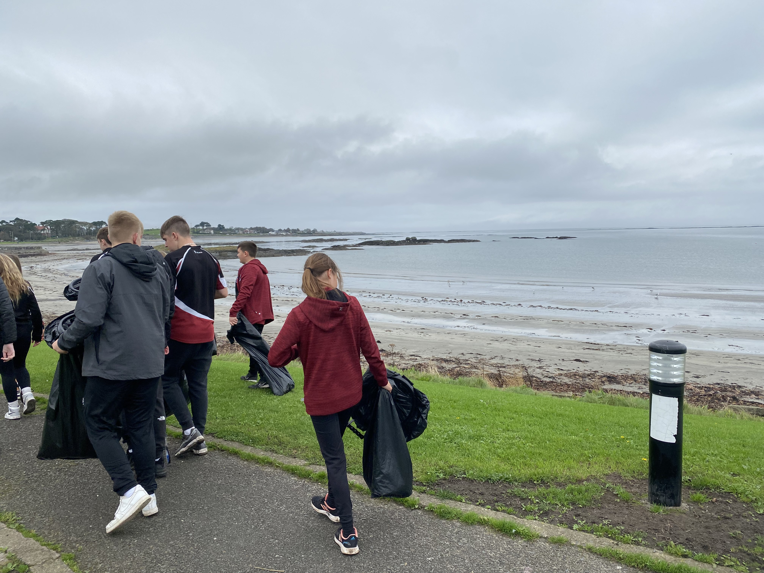
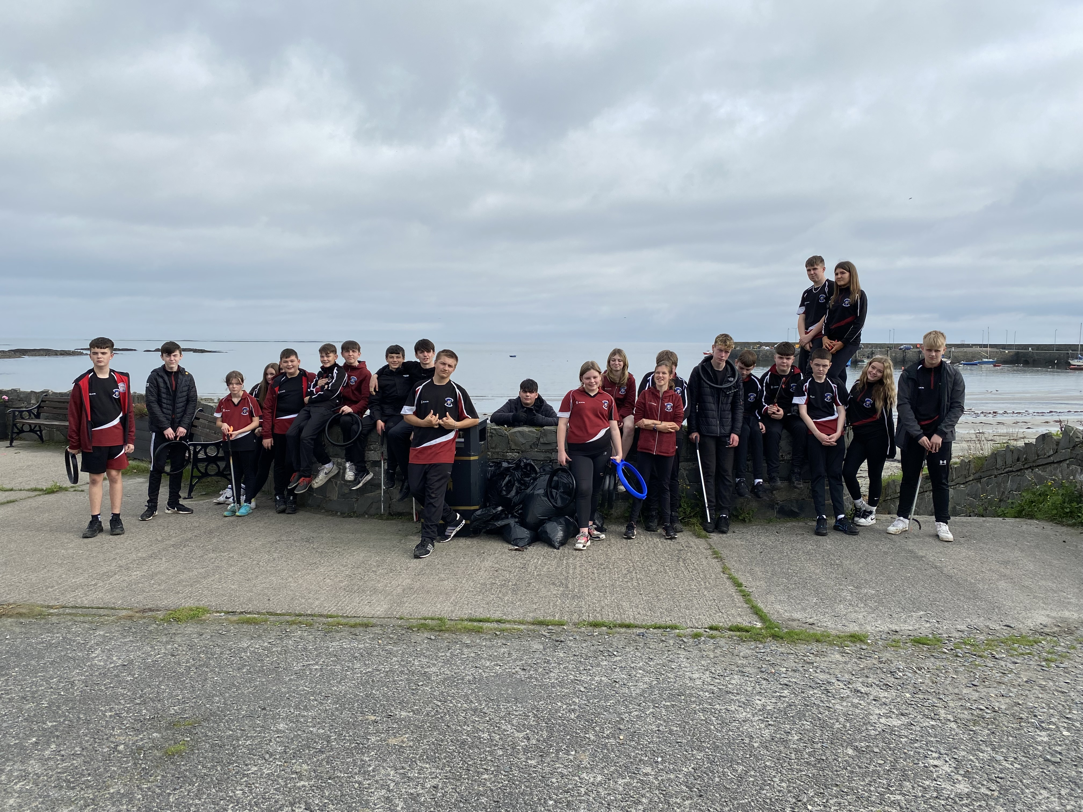
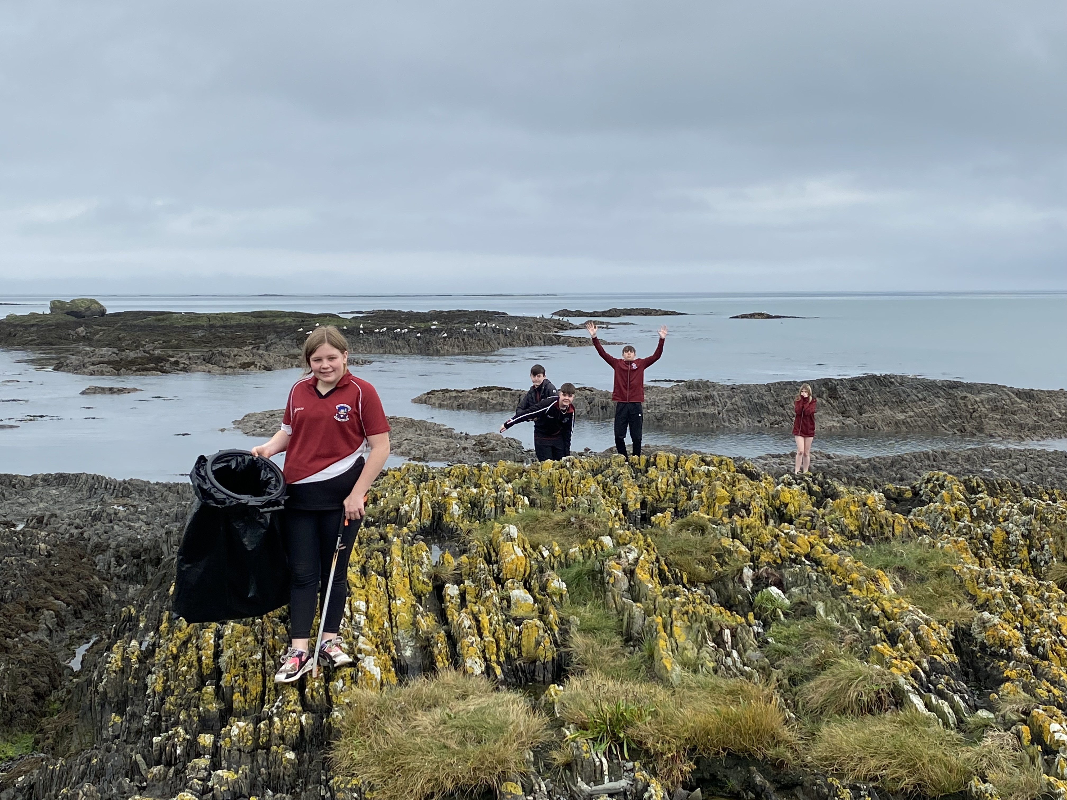
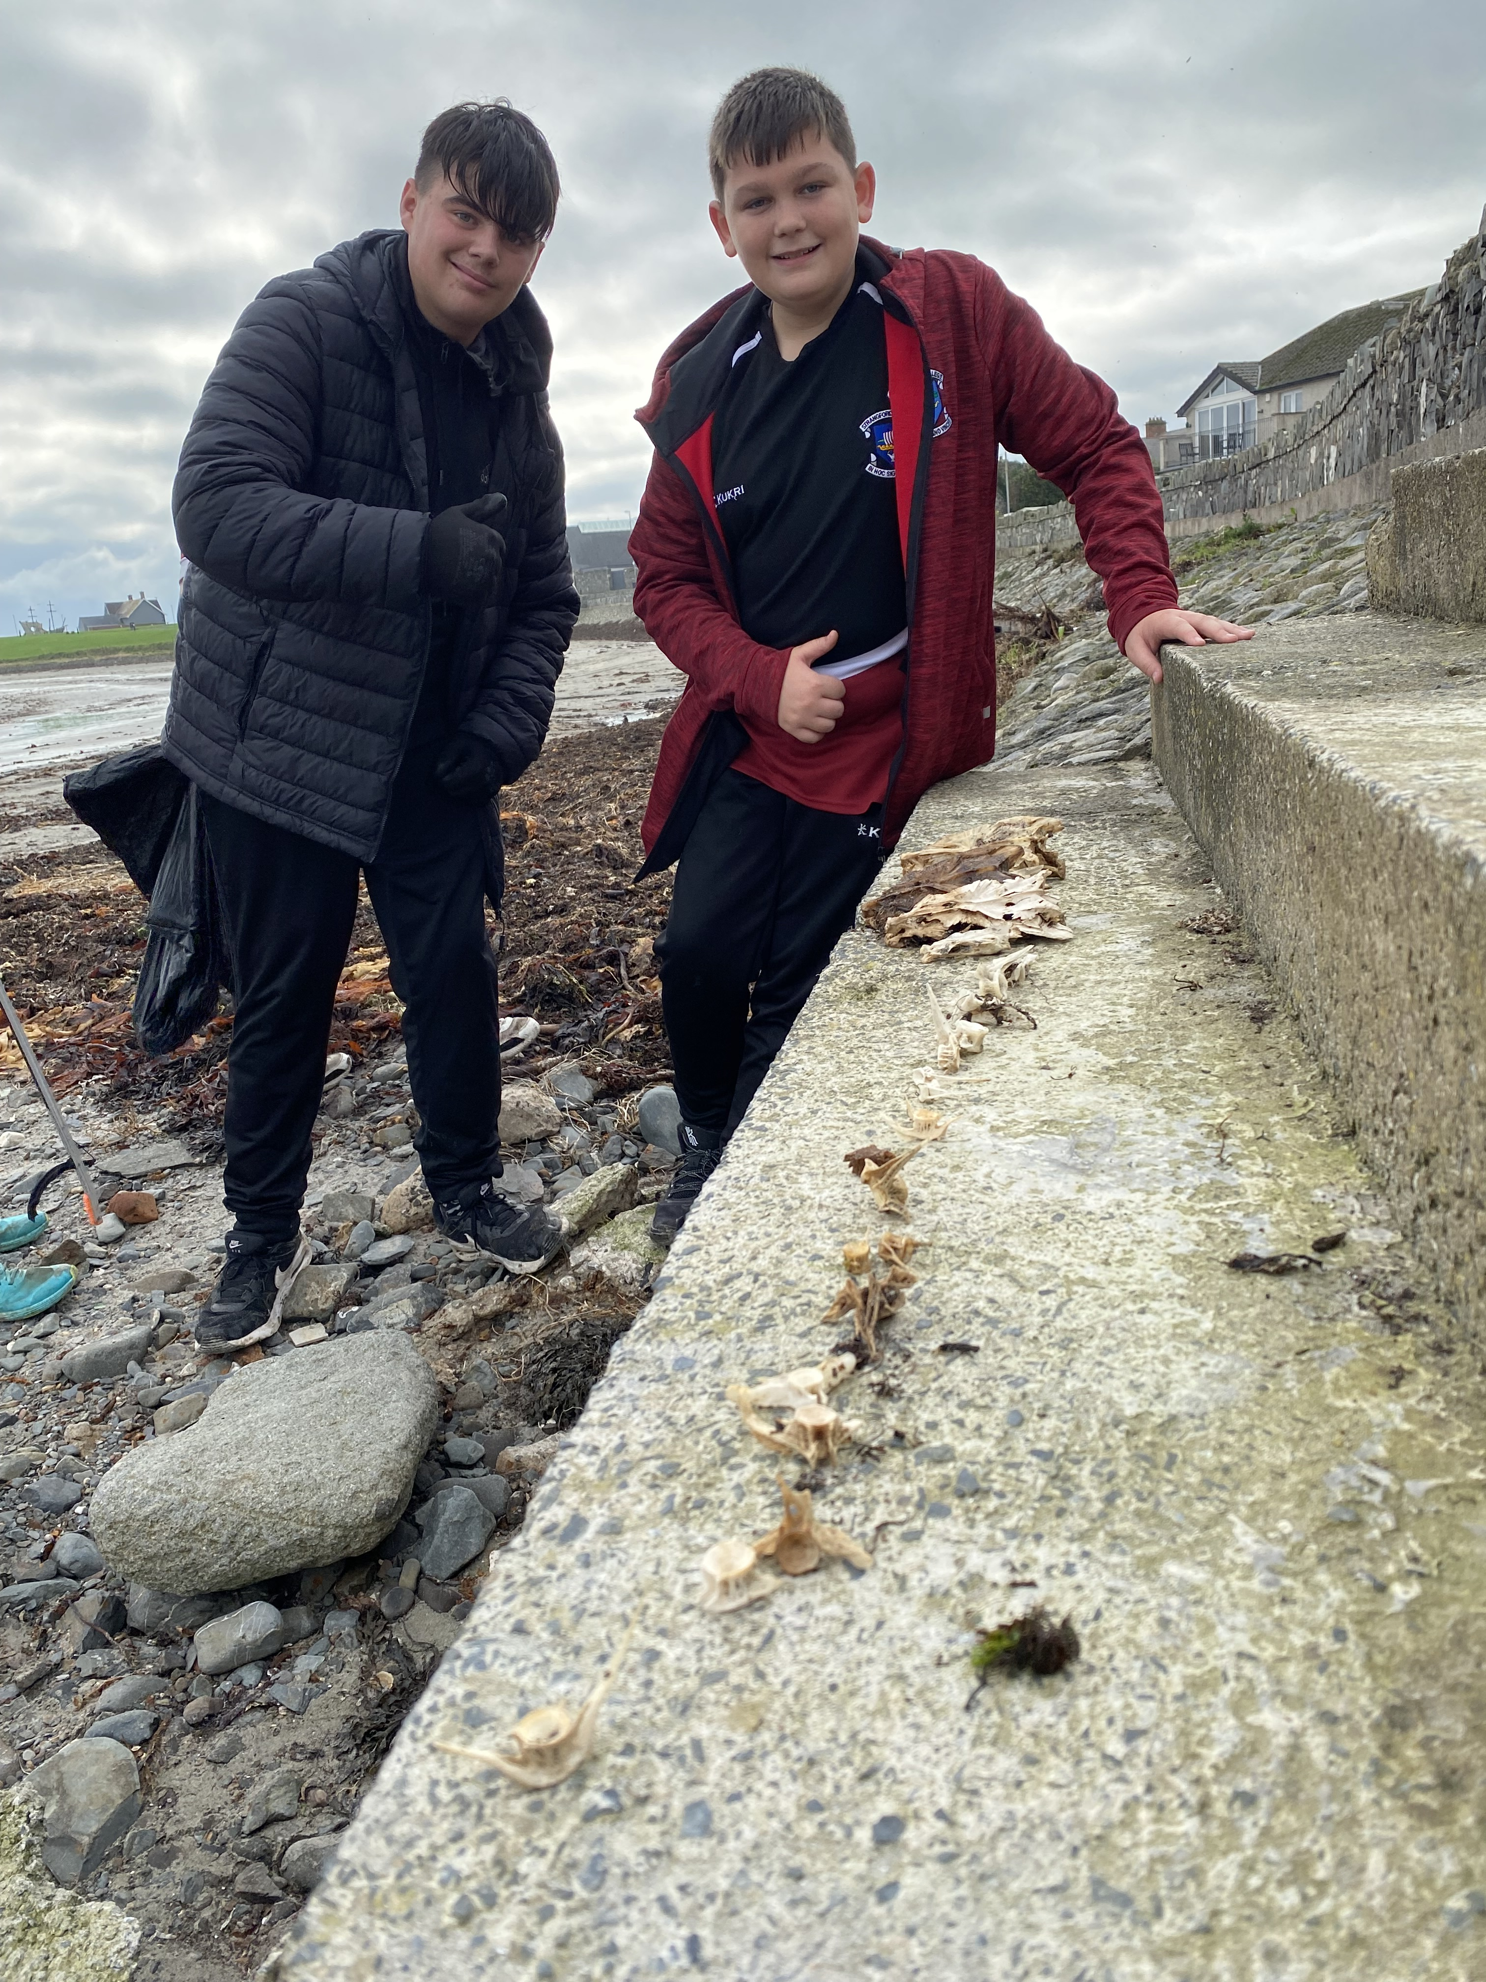
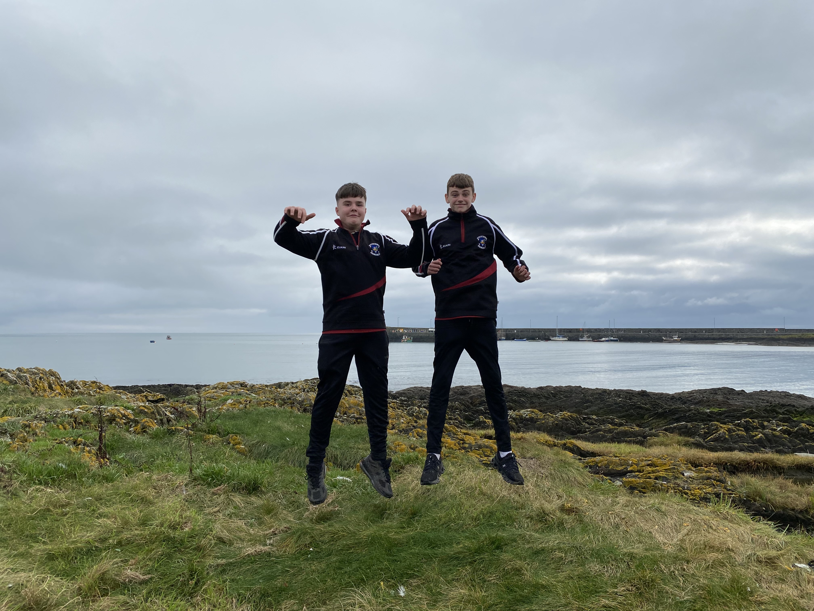
SHARED ED BEACH CLEAN
BALLYWALTER BEACH
OCTOBER 2023
Year 10 had the opportunity to complete a shared education beach clean of Ballywalter Beach in connection with St Columbus School from Portaferry. As you can see the students done an amazing job of cleaning up this space for both the public and for the wildlife that inhabit this area. A total of 5 bags of rubbish were collected by our students.

